Slide 1
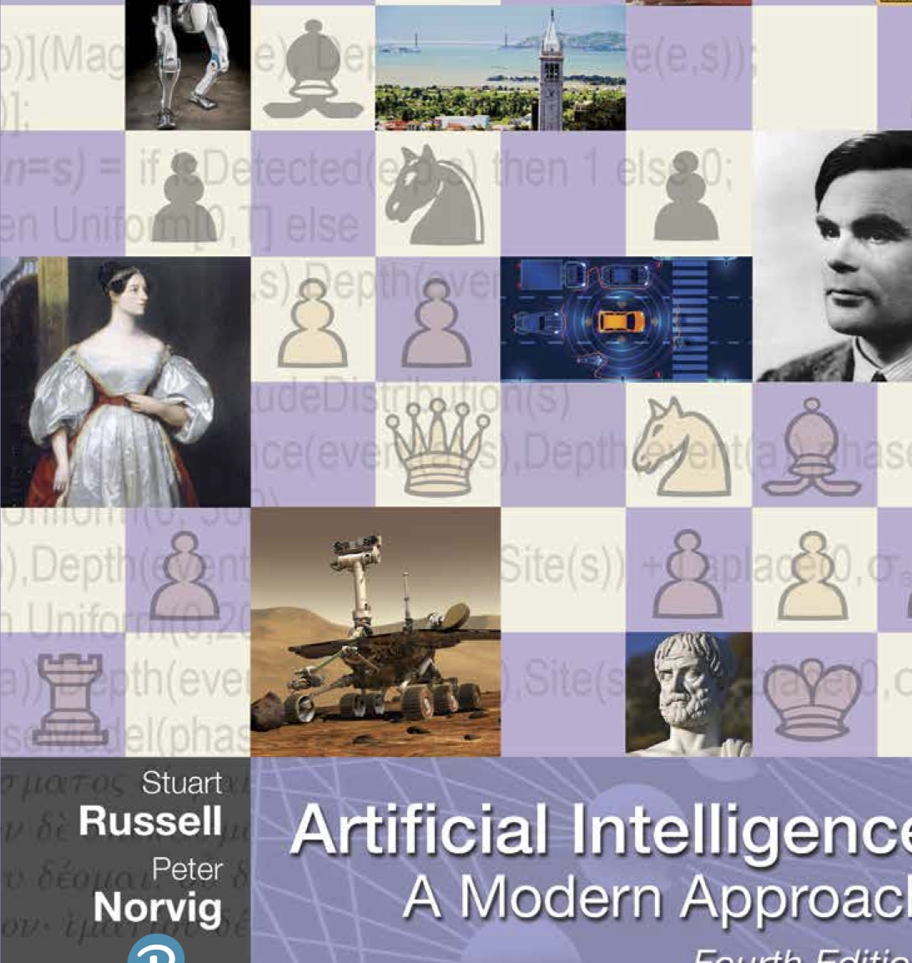


CS 5/7320 Artificial Intelligence Introduction to AI AIMA Chapters 1 + 27
Slides by Michael Hahsler based on slides by Svetlana Lazepnik with figures and cover art from the AIMA textbook.
This work is licensed under a Creative Commons Attribution-ShareAlike 4.0 International License.
Online Material

Slide 2
Agenda
What is AI?
AI Today
History of AI
?
AI Ethics & Safety

Slide 3
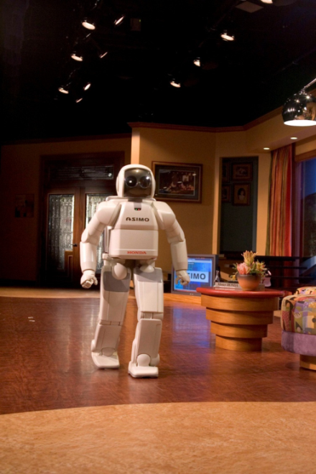

What is Artificial Intelligence?
ASIMO (Advanced Step in Innovative Mobility) is a humanoid robot created by Honda in 2000

Slide 4
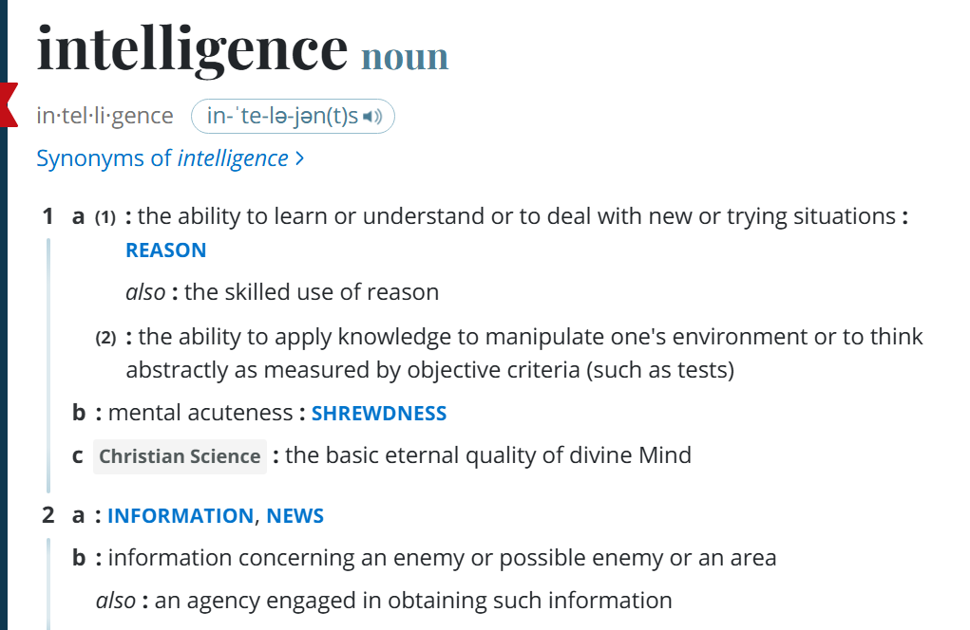
What is Intelligence?
Definition from Merriam-Webster

Slide 5

The Goal of AI
“Have machines solve problems that are challenging for humans.”
We call such a machine an intelligent agent.
Narrow AI
Artificial General Intelligence (AGI)
Artificial Superintelligence
An intelligent agent that can solve a specific problem. E.g., drive a car or play chess.
A hypothetical intelligent agent which can understand or learn any intellectual task that human beings can. [Wikipedia: AGI]
A hypothetical intelligent agent possessing intelligence surpassing that of the brightest and most gifted human minds. [Wikipedia: Superintelligence]
How can we achieve this? Create an agent that can:
Think like a human?
Act like a human?
Think rationally?
Act rationally?

Slide 6
Cognitive Sciences
Think like a human?
Act like a human?
Think rationally?
Act rationally?
The brain as an information processing machine.
How to understand cognition as a computational process?
Introspection: try to think about how we think.
Predict the behavior of human subjects.
Image the brain, examine neurological data
Requires scientific theories of how the brain works. Note: The brain does not work like artificial neural networks from machine learning!
AI consciousness
What does it mean that a machine is conscient/sentient?
How can we tell?
What do we do then?
Moral Philosophy

Slide 7
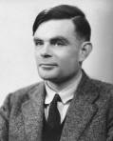
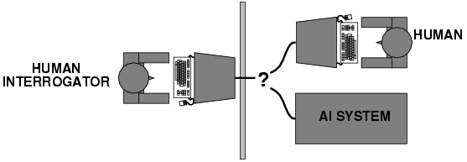
Alan Turing (1950) “Computing machinery and intelligence”
Think like a human?
Act like a human?
Think rationally?
Act rationally?
Alan Turing rejects the question “Can machines think?”
The Turing Test tries to define what acting like a human means.
What capabilities would a computer need to have to pass the Turing Test? These are still the core AI areas.
Natural language processing
Knowledge representation
Automated reasoning
Machine learning
Turing predicted that by the year 2000, machines would be able to fool 30% of human judges for five minutes. ChatGPT (2023) is probably doing a least that!
Needs to decide if she talks to a human or an AI system.

Slide 8
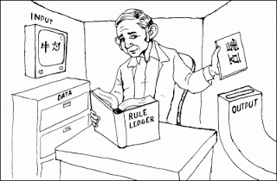
Turing Test: Criticism
What are some potential problems with the Turing Test?
Some human behavior is not intelligent.
Some intelligent behavior may not be human.
Human observers may be easy to fool.
A lot depends on expectations.
Anthropomorphic fallacy: humans tend to humanize things.
Imitate intelligence without intelligence. E.g., the early chatbots ELIZA (1964) simulates a conversation using pattern matching.
Is passing the Turing test a good scientific goal?
Engineering perspective: Imitating a human is not a good way to solve practical problems.
We can create useful intelligent agents without trying to imitate humans.
Chinese Room Argument
Thought experiment by John Searle (1980): Imitate intelligence using rules.

Slide 9
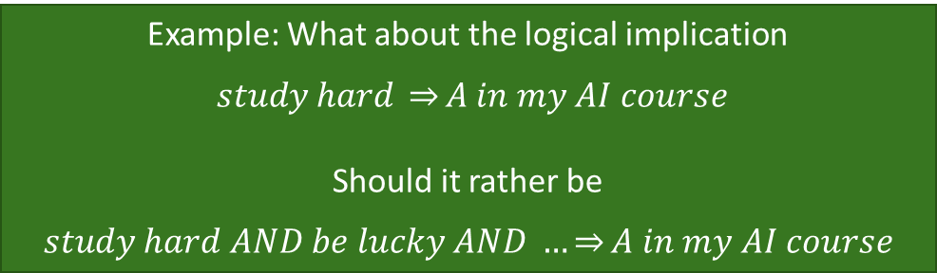
Thinking Rationally?
Think like a human?
Act like a human?
Think rationally?
Act rationally?
Thinking Rationality: Draw sensible conclusions from facts, logic and data.
Logic: A chain of argument that always yield correct conclusions. E.g., “Socrates is a man; all men are mortal; therefore, Socrates is mortal.”
Logic-based approach to AI: Describe a problem in formal logic notation and apply general deduction procedures to solve it. Issues:
Describing real-world problems and knowledge using logic notation is hard.
Computational complexity of finding the solution.
Much intelligent or “rational” behavior in an uncertain world cannot be defined by simple logic rules.
Example: What about the logical implication
$study hard \underset{⇒}{}A in my AI course$
Should it rather be
$$study hard AND be lucky AND …\underset{⇒}{}A in my AI course$$

Slide 10
Acting Rationally
Think like a human?
Act like a human?
Think rationally?
Act rationally?
Acting rational means to try to achieve the “best” outcome.
Best means that we need to do optimization.
The desirability of outcomes can be measured by the economic concept of utility. If there is uncertainty about achieving outcomes, then we need to maximizing the expected utility.
Optimization has several advantages:
Generality: optimization is not limited to logical rules.
Practicality: can be adapted to many real-world problems.
Well established: existing solvers and methods for simulation and experimentation.
Avoids philosophy and psychology in favor of a clearly defined objective.
Bounded rationality: In practice, expected utility optimization is subject to the agent’s knowledge and computational constraints. The agent needs to do the best with its knowledge and resources.

Slide 11
The Type of AI is Covered in this Course
think like a human?
act like a human?
think rationally?
act rationally.
This course focuses on the computational techniques needed to creating a narrow AI agent that can
That is, create a machines that acts in a way to solve a specific hard problem that traditionally would have been thought to require human intelligence.

Slide 12
Intelligent Agents
Machines that act rationally.
ASIMO (Advanced Step in Innovative Mobility) is a humanoid robot created by Honda in 2000

Slide 13

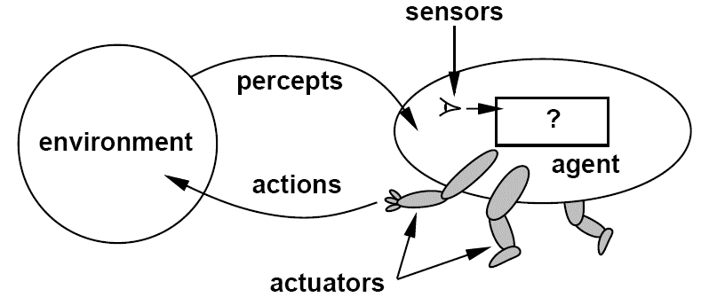
Components of an Intelligent Agent
Intelligent agents act rationally in their environment.
They need to
Communicate with the environment using percepts and actions.
Represent knowledge, reason and plan to achieve a desired outcome.
Optional
Learn from experience to improve performance.
Developer
Agent interacting with the environment [Artificial Intelligence: A Modern Approach, Editions 1-3]

Slide 14
Artificial Intelligence vs. Machine Learning
AI
Designing an intelligent agent
Sensing
Vision
Robotics
Natural Language Processing
Knowledge representation
Planning
ML
Learning from examples instead of being programmed
Supervised learning
Unsupervised learning
RL
Deep Learning
ML
ML
ML
Agent interacting with the environment [Artificial Intelligence: A Modern Approach, Editions 1-3]

Slide 15
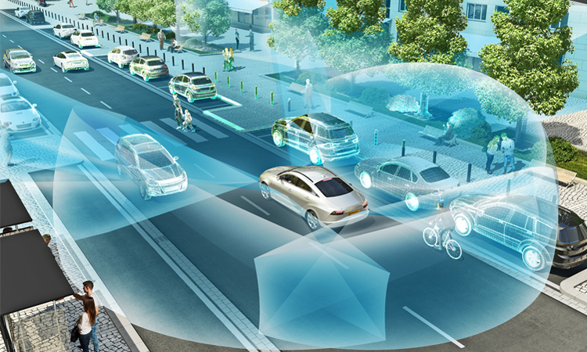
Example: Self-Driving Car
Percepts:
Action:
Objective:
Other objects including people crossing the street.
Slow down or stop the car.
Reach the destination safely

Slide 16

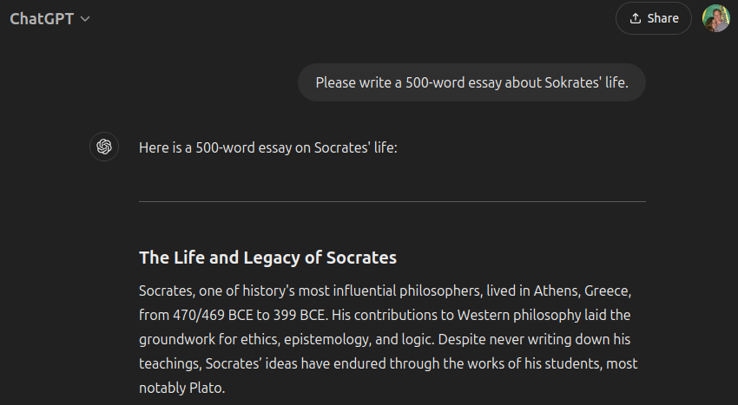
Example: Homework and LLMs
Percept:
Action:
Objective:
Your prompt
Next most likely word… More words are created word-by-word.
You may like a useful answer, but what is ChatGPT’s objective?

Slide 17
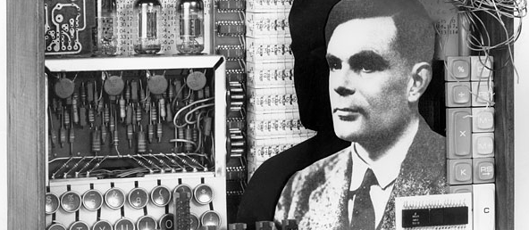
The History of AI

Slide 18
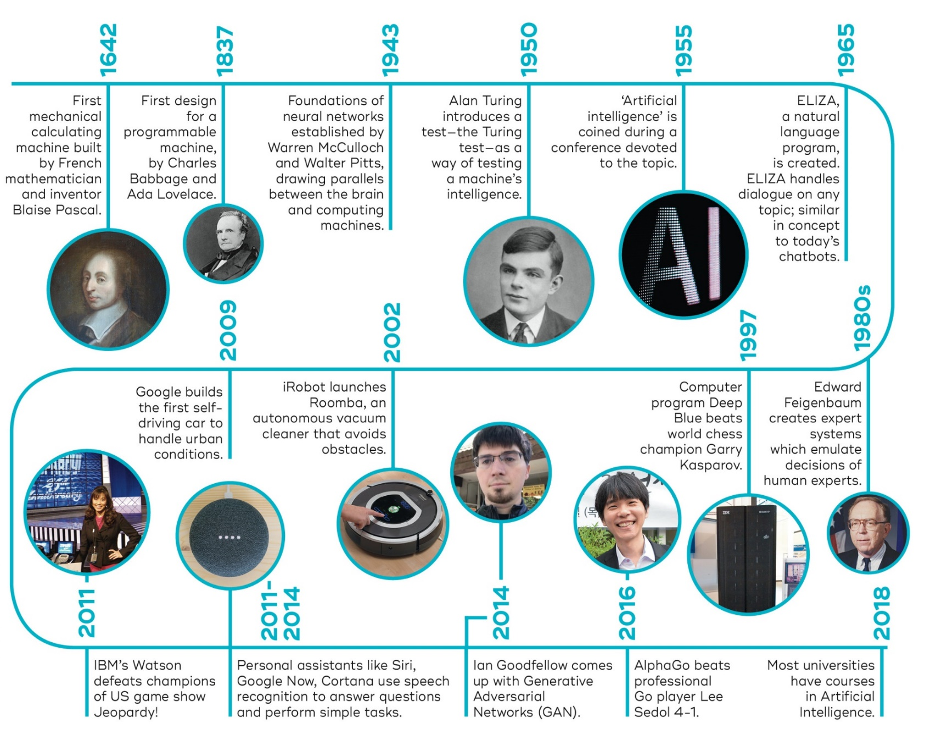



The Timeline of AI Development
1974-1980
First AI Winter
1989
1989: Universal approximation theorem for artificial neural networks
1987- 1993
Second AI Winter
2010
2015
2017
2022
Transformer architecture and large language models LLMs
Generative AI models:
DALL-E
ChatGPT, Bard
…
Deep Learning Revolution (learning layered artificial neural networks) starts fueled by NVIDIA GPUs. enables leaps in image processing and speech recognition.
Now Google
Source: https://qbi.uq.edu.au/brain/intelligent-machines/history-artificial-intelligence + additions

Slide 19
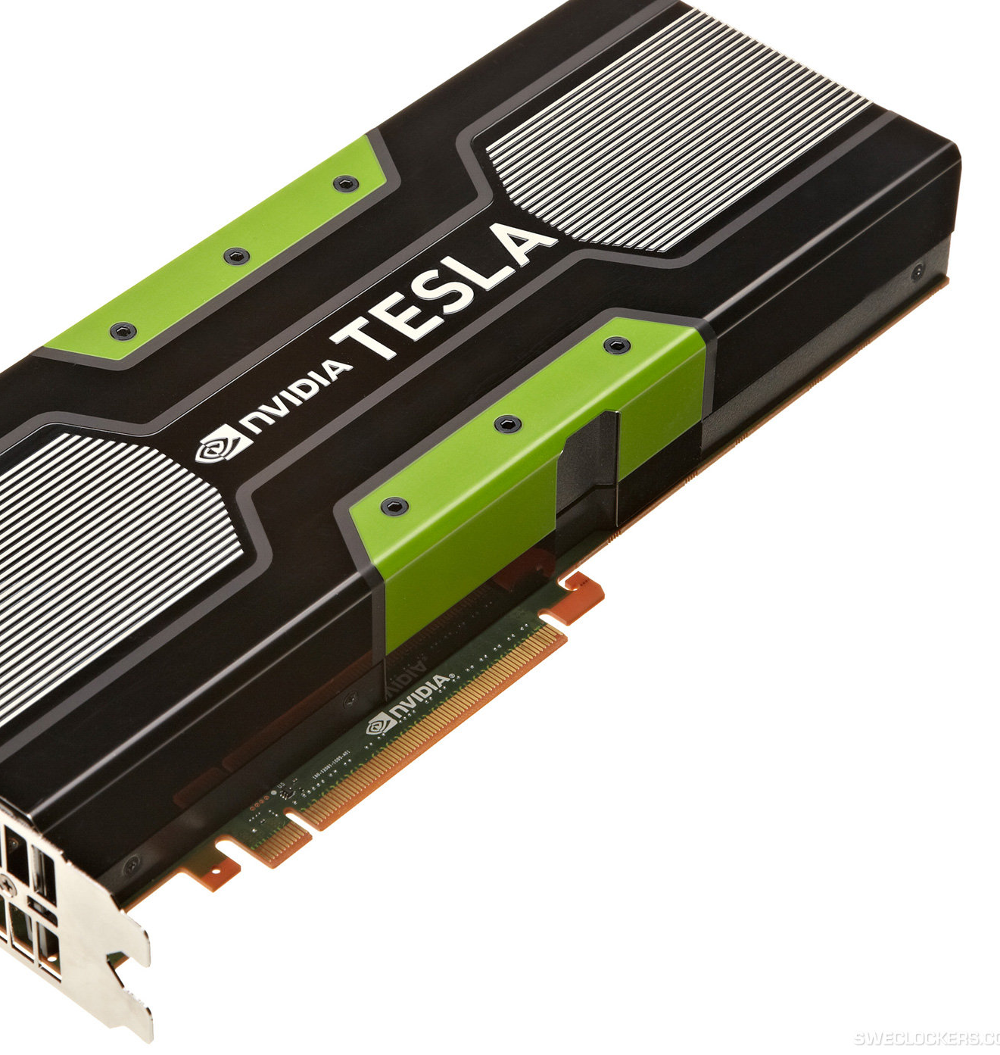
What accounts for recent successes in AI?
Dominance of machine learning.
Faster computers and specialized hardware (GPUs).
Lots of data (the Internet, text, sensors) and storage (cloud)
New optimization methods (deep learning).

Slide 20
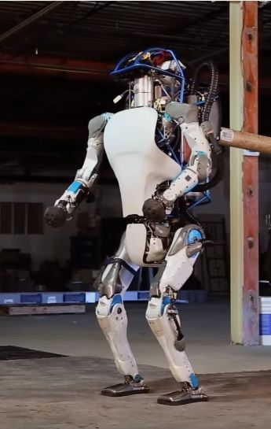
“Moravec’s Paradox”
Hans Moravec (1988): “It is comparatively easy to make computers exhibit adult level performance on intelligence tests or playing checkers, and difficult or impossible to give them the skills of a one-year-old when it comes to perception and mobility.”
A teenager can learn how to drive in a few hours with very little input, but we still have no truly self-driving car.
https://www.newsweek.com/googles-new-two-legged-robot-future-warfare-429831

Slide 21
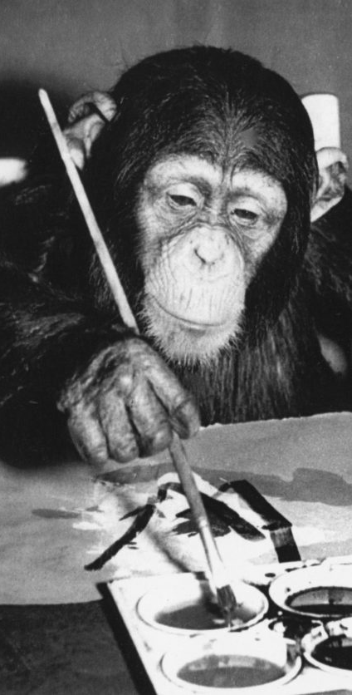
The AI Effect: AI gets no respect?
As soon as a machine gets good at performing some task, the task is no longer considered to require much intelligence.
Calculating ability used to be prized – not anymore.
Chess was thought to require high intelligence – now computers play at a super-human level.
Learning once thought uniquely human - now machine learning is a well-developed discipline.
Art? “Even a monkey can do this!”

Slide 22
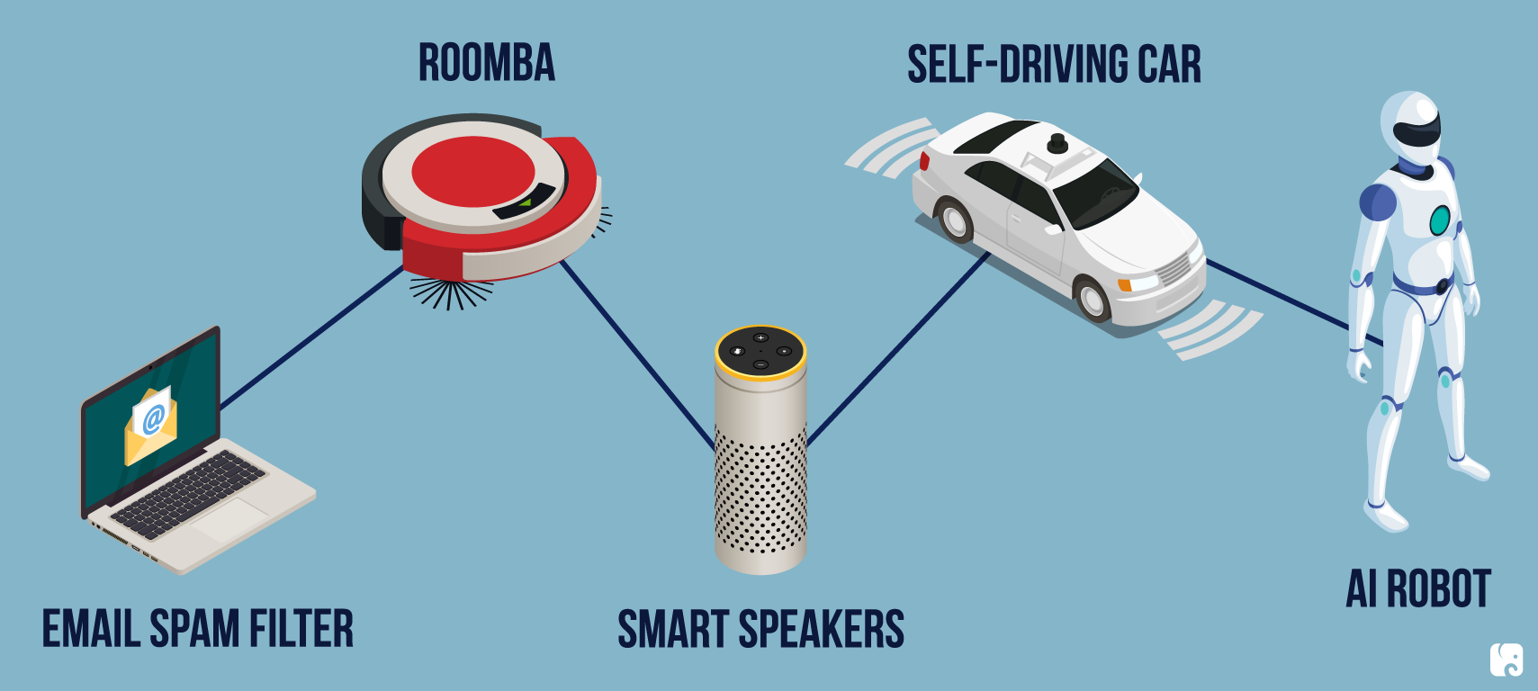
AI Today

Slide 23
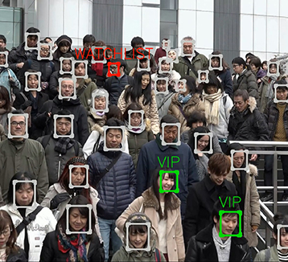
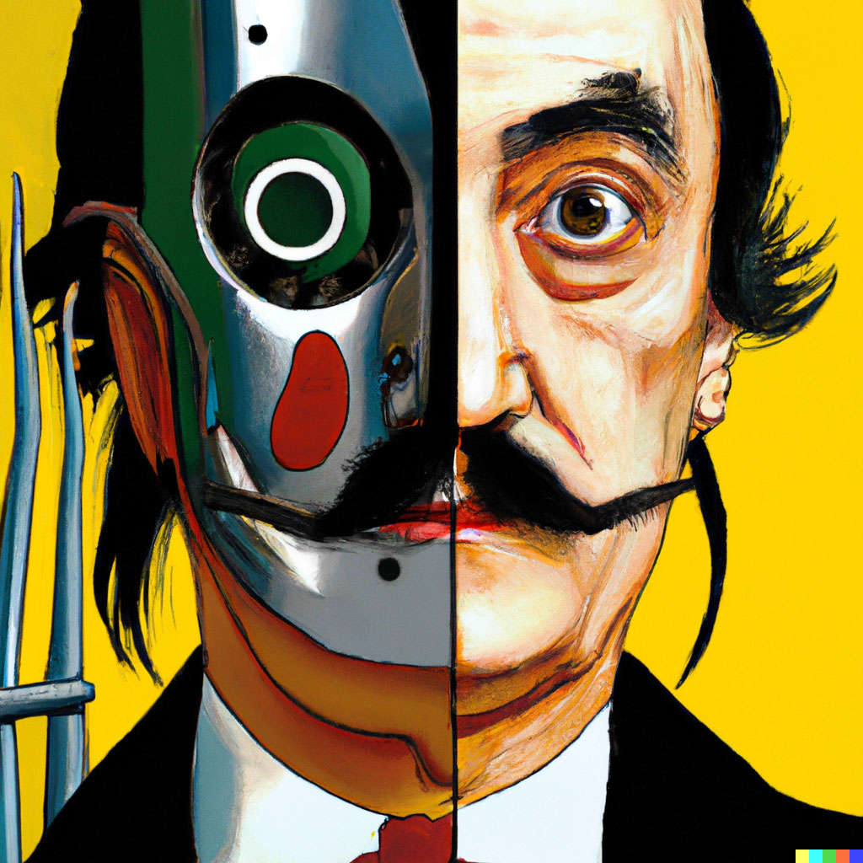


Vision and Image Processing
OCR: read license plates, handwriting recognition (e.g., mail sorting).
Face detection: now standard for smart phone cameras.
Vehicle safety systems
Visual search
Image generation
All these technologies operate now at superhuman performance.
DALL-E

Slide 24
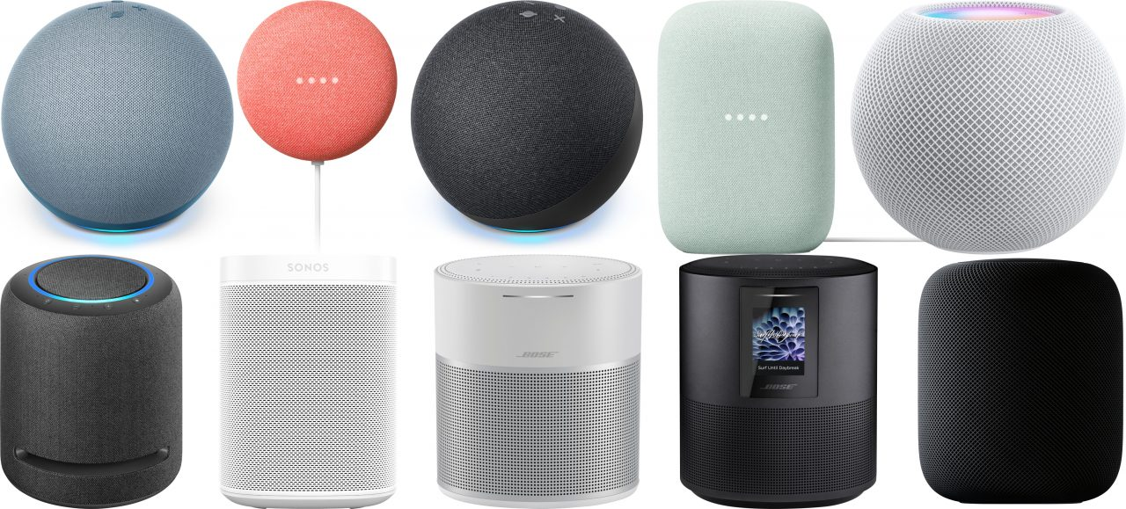
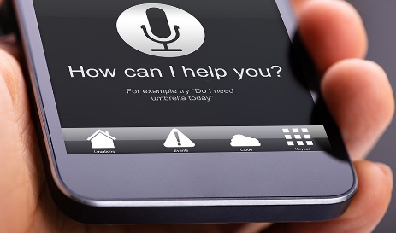


Natural Language Processing
Text-to-speech
Speech-to-text to detect voice commands
Machine translation
Text generation (Q/A systems) using Large Language Models
These technologies operate now with close to or even superhuman performance.
Humans use language to reason. Does that mean AI that can create high-quality text can reason?
Language understanding is still elusive!

Slide 25
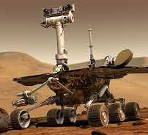
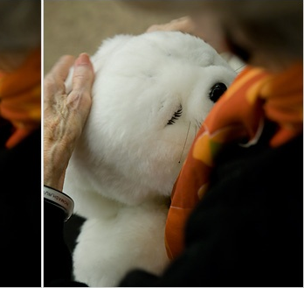
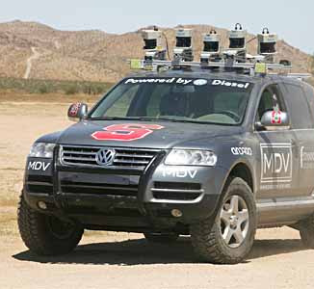
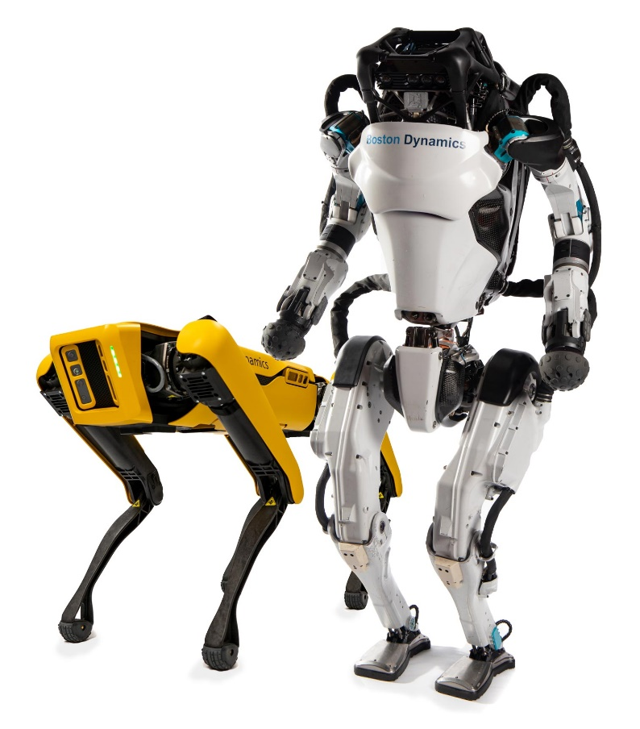
Robotics
Mars rovers
Robot soccer
RoboCup
Autonomous vehicles
DARPA Grand Challenge
Self-driving cars
Drones
Personal robotics
Humanoid robots
Robotic pets
Personal assistants?

Slide 26
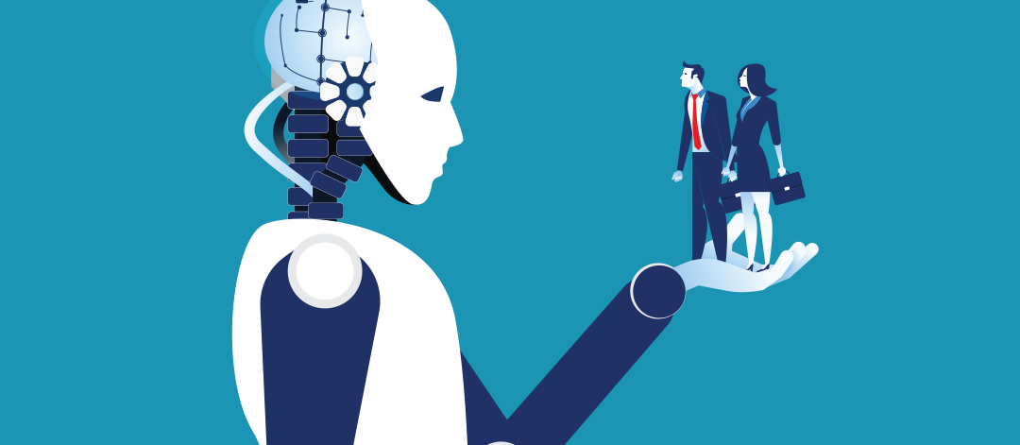
AI Ethics & Safety
A new Frontier for Fairness and Freedom AIMA Chapter 27

Slide 27
Commonly-Cited Safety and Ethics Principles
Use of AI by companies and organizations
Ensure safety
Protect individuals
Uphold human rights and values.
Limit harmful uses of AI
Establish accountability: Liability?
Avoid concentration of power: Winner-takes-All
Ensure fairness: Equal opportunity/equal impact. Reflect diversity/inclusion
Provide transparency: Explanations to build trust
Respect privacy: Surveillance?
Contemplate implications for employment: Income and purpose.
Governance
Acknowledge legal/policy implications
Next, we look at the implementation of these principles in different countries.

Slide 28

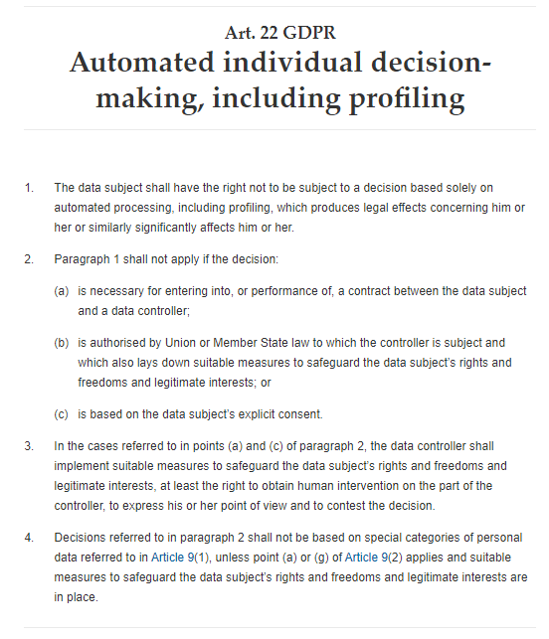

European Union
2016
Has regulations since 2016 included in the General Data Protection Regulation (GDPR)
Art. 22 GDPR – Automated individual decision-making, including
California’s CCPA was not modeled after the GDPR

Slide 29
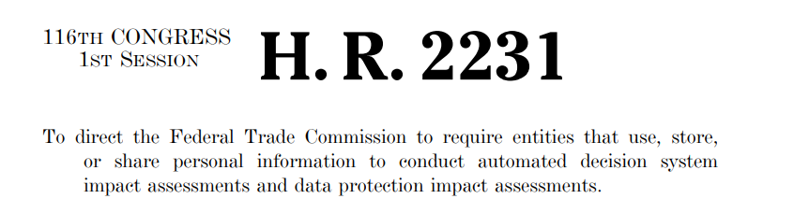
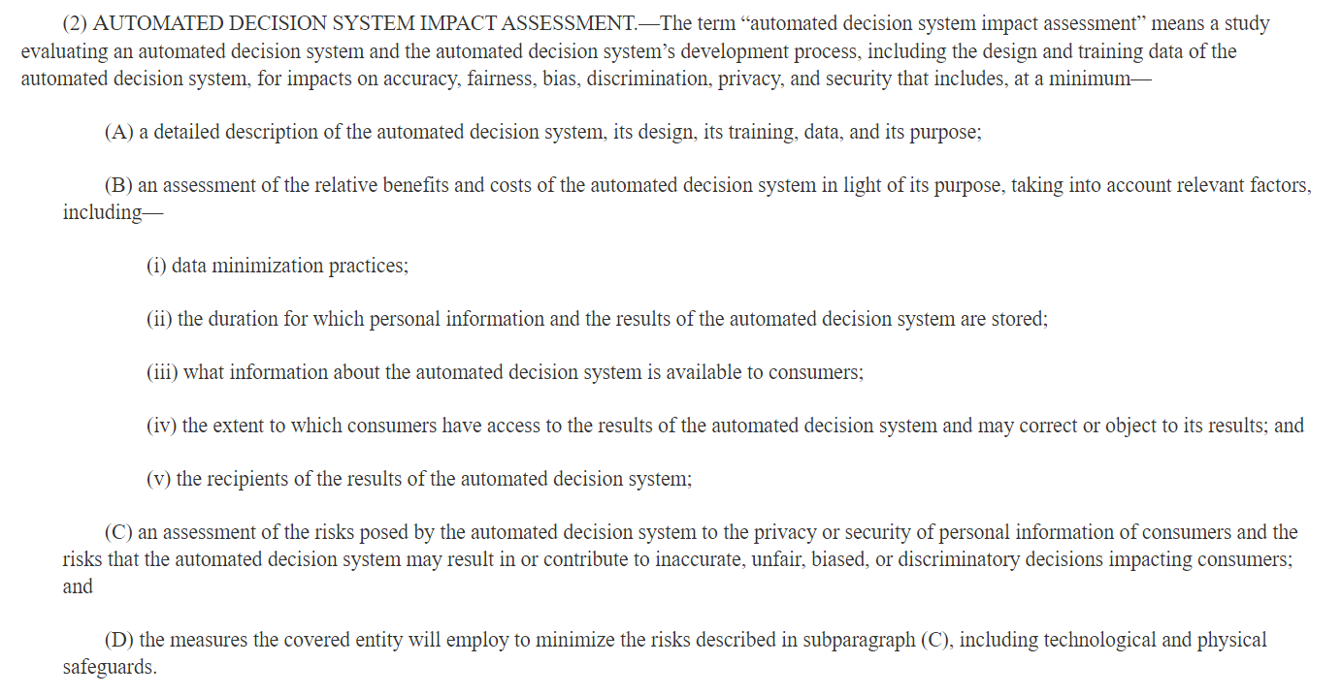
In the United States
Bill Introduced was 2019
Did not receive a vote in Congress.

Slide 30
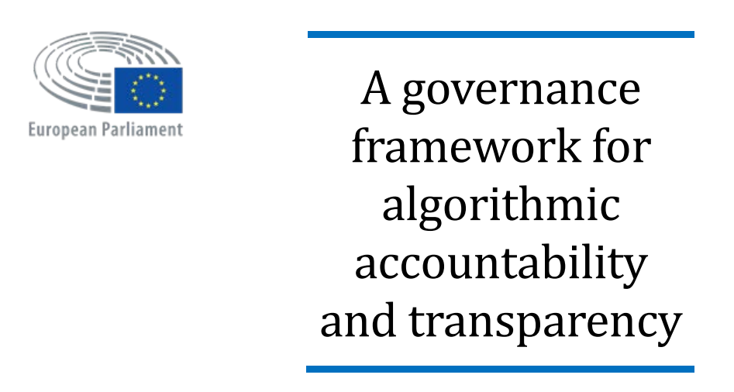
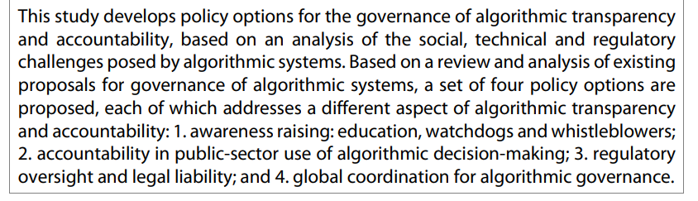
European Union Study
2019
https://www.europarl.europa.eu/thinktank/en/document.html?reference=EPRS_STU(2019)624262

Slide 31
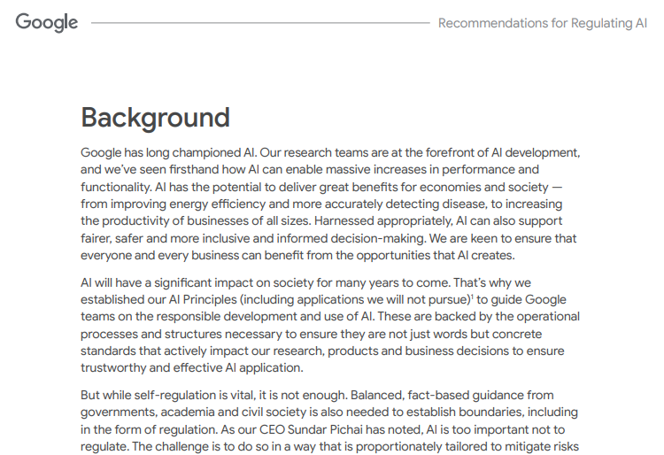
Google
2021
Source: https://ai.google/static/documents/recommendations-for-regulating-ai.pdf, 2021

Slide 32
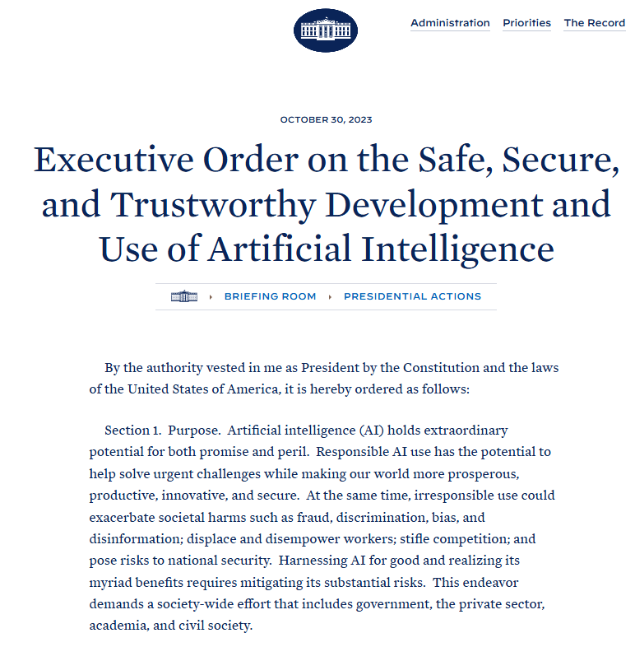
US White House Executive Order 14110
2023
Some important points:
Artificial Intelligence must be safe and secure.
Promoting responsible innovation, competition, and collaboration
Americans’ privacy, civil liberties and labor rights must be protected.
January 2025: This Executive Order is now revoked.

Slide 33



Fairness: Algorithmic Bias
“Algorithmic bias describes systematic and repeatable errors in a computer system that create unfair outcomes, such as privileging one arbitrary group of users over others.” [Wikipedia]
Pre-existing bias
Technical bias
Emergent bias
Social and institutional norms influence design and training data choices.
Example: Evaluate job applicants for a job which is historically almost exclusively held by males.
Limitations of a program or computational power.
Example: Algorithm uses data that is easy to obtain but biased.
Use and reliance on algorithms across new or unanticipated contexts.
Example: Use a large language model to support job candidate selection.

Slide 34



Types of AI Safety
“Prevent accidents, misuse, or other harmful consequences of AI.”
AI Testing
Monitoring AI
Adversarial robustness
How should this be ensured?
Corporate self-regulation
Private watchdogs
Government action
International treaties
Is it reasonable to assume that a superintelligent AI can get around being tested and monitored?

Slide 35
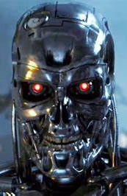

AI Safety and Optimizers
Intelligent Agents are “optimizers!”
Goal/reward alignment: How do we specify a robust objective function? Whose objectives are used?
Reward hacking: The AI learns to exploit unintended side effects to get a high “score” without solving the objective. AI needs to follow social norms.
Instrumental convergence: All intelligent agents will pursue common subgoals like the need for more power to get better at reaching its objectives. How will this need be balanced with human’s needs?
Instrumental convergence
Alignment?
Goals
Objectives and Rules
Reward hacking
Intelligent Agent
User
Side effect
Action
Alignment?
program
train
Goals
select
Data
Developers / Owners
Credit: Terminator 3: Rise of the Machines. Warner Bros.

Slide 36
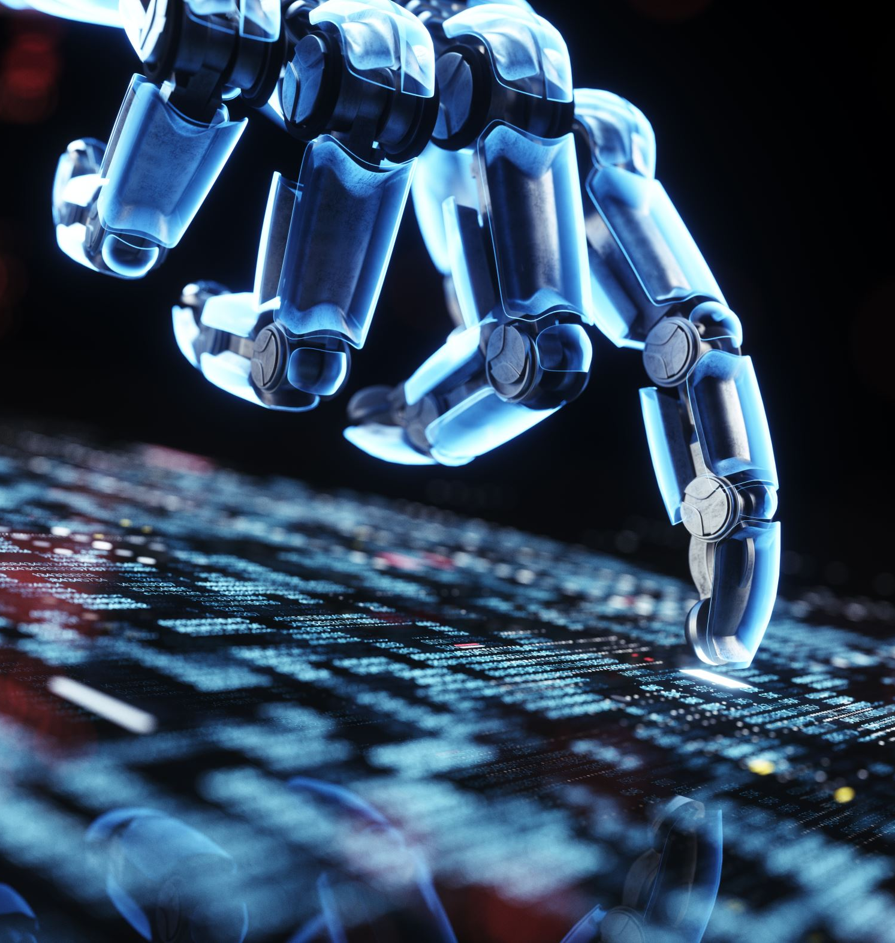
Outlook
AI is a technology that is on the verge of significant leaps…
New technologies always had a profound impacted on the way we live and work (e.g., electricity, the internet, mobile communication).
We can expect unprecedented gains in productivity from better narrow AI.
New technologies always also present dangers and need to be regulated.
This course will introduce simple techniques to create intelligent agents.

